Slide 1
PREPAID TAXI BOOKING

Slide 2
PRESENTED BY
Shreyan Saha
Subrata Pal
Jayant Mitra
Md Nurul Islam
Allama Abul Kalam Azad

Slide 3
OBJECTIVE
Develop a system that can replace the manual taxi booking system
Develop a database which stores driver details and destination details
Give reliable search facility for the users.
Create an easy to understand user friendly environment
Attractive user interfaces to navigate through the system for users

Slide 4
FUNCTIONAL REQUIREMENT
The system allows user to login.
One will be automatically redirected to signup page if not an existing user.
Upon successful login the user will be directed to the Home page.
From here we can view the current rate chart, driver database and current ongoing trips.
Menu options are present to add or remove drivers, change rates, cancel bookings.

Slide 5
RESOURCES REQUIRED
Hardware Required:
1)A computer with 256 MB RAM
2)64 or 32 bit Operating System
Software Required:
1)Eclipse(Mars 2)
2)Java SE Development Kit 8

Slide 6
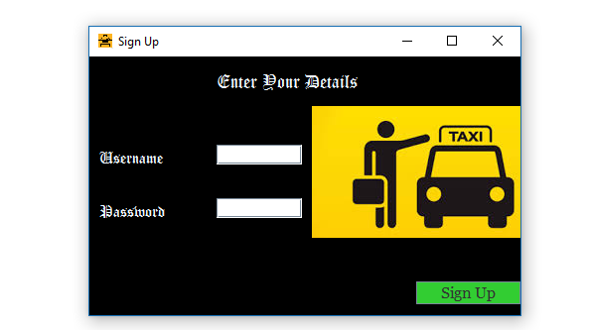
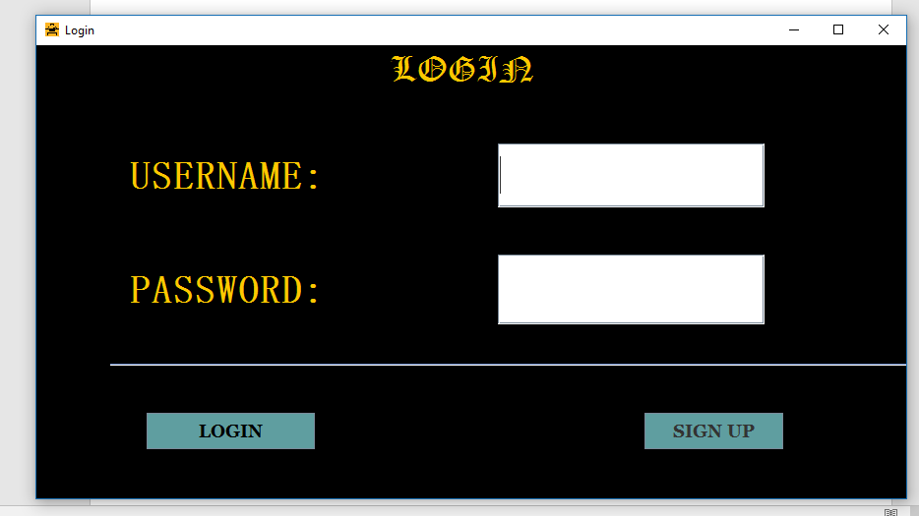
LOGIN AND SIGNUP PAGE

Slide 7
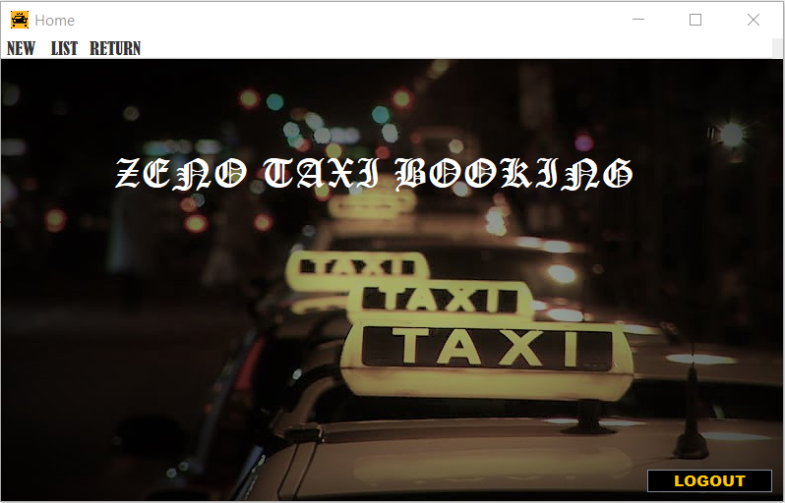
HOME PAGE

Slide 8
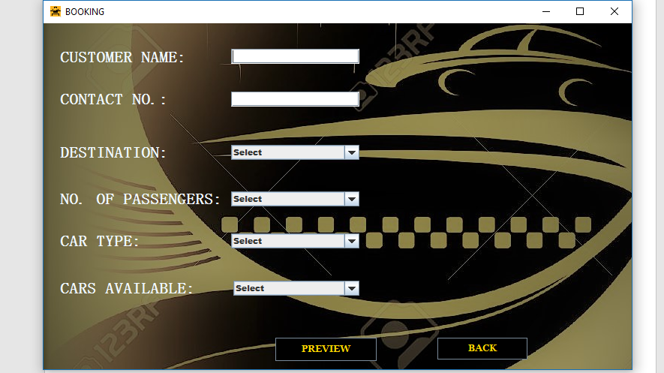
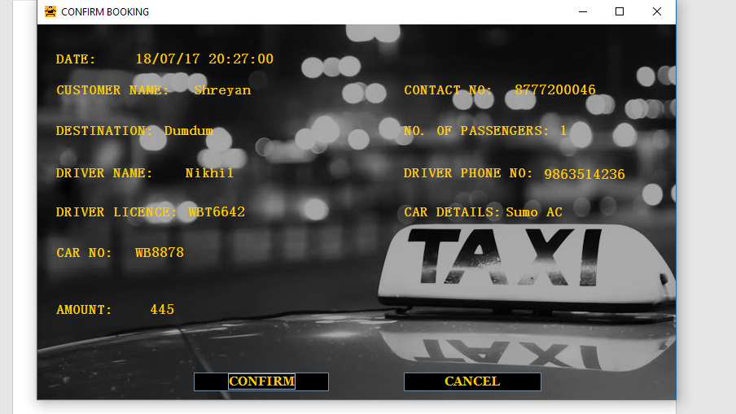
BOOKING AND CONFIRM PAGE

Slide 9
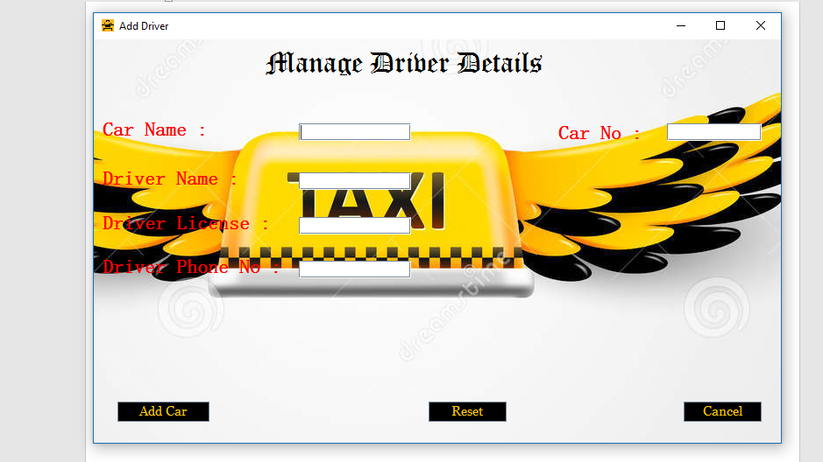
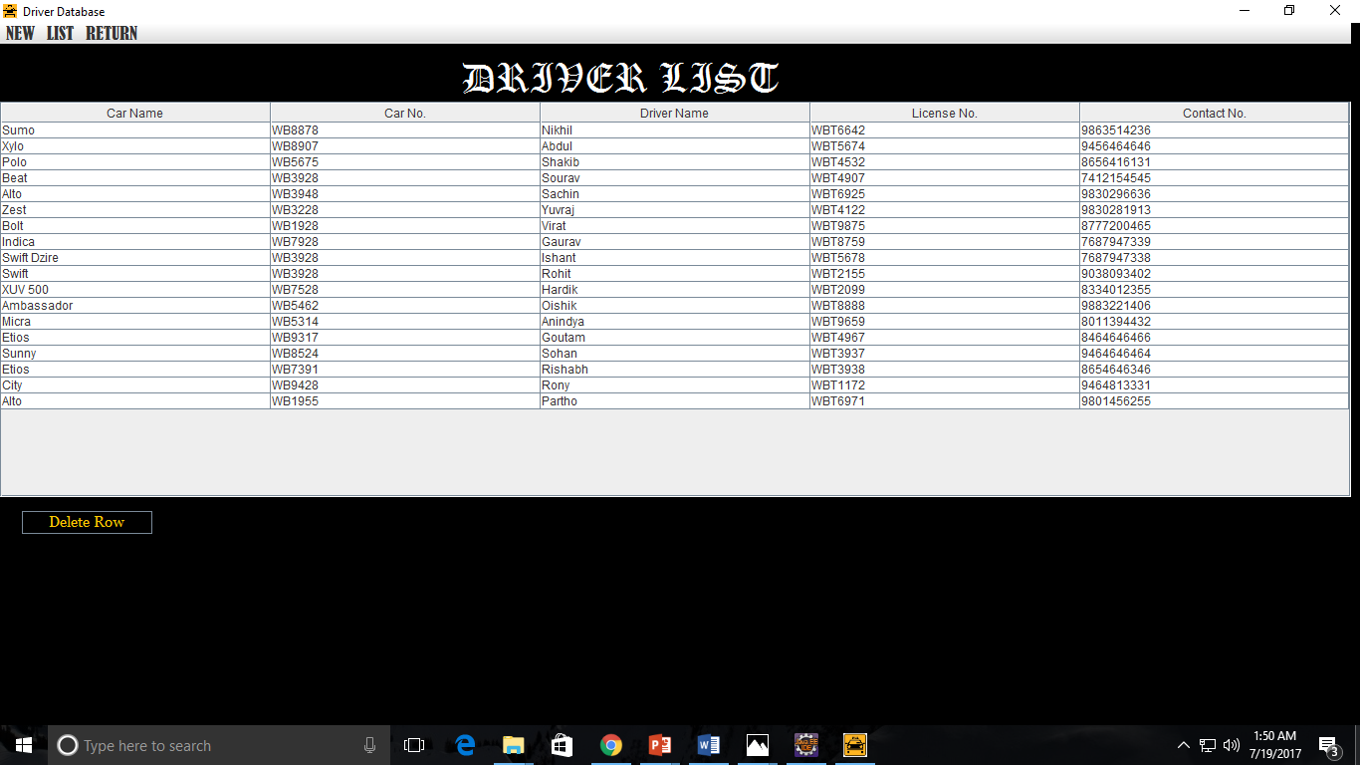
ADD DRIVER AND DRIVER LIST

Slide 10
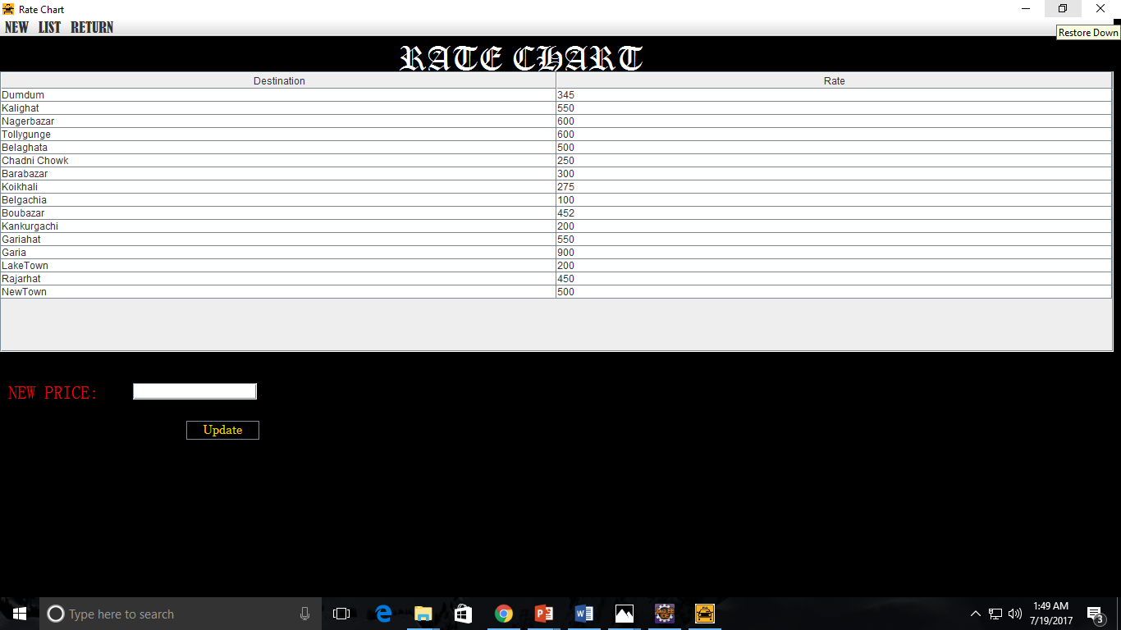
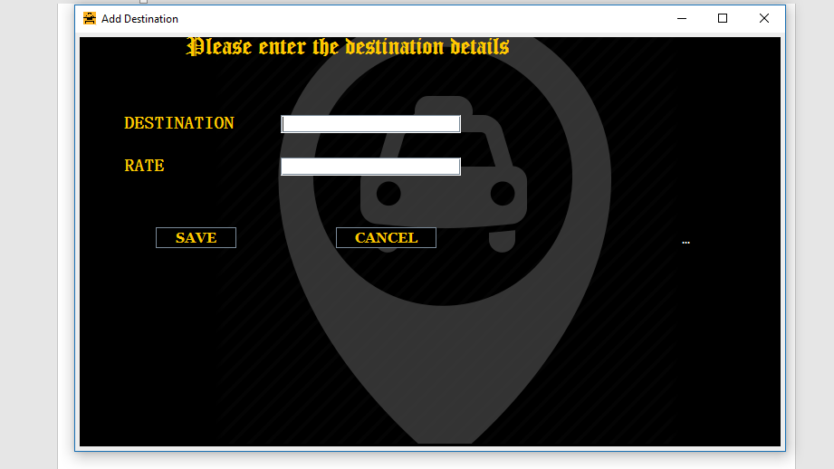
RATE CHART AND ADD DESTINATION

Slide 11
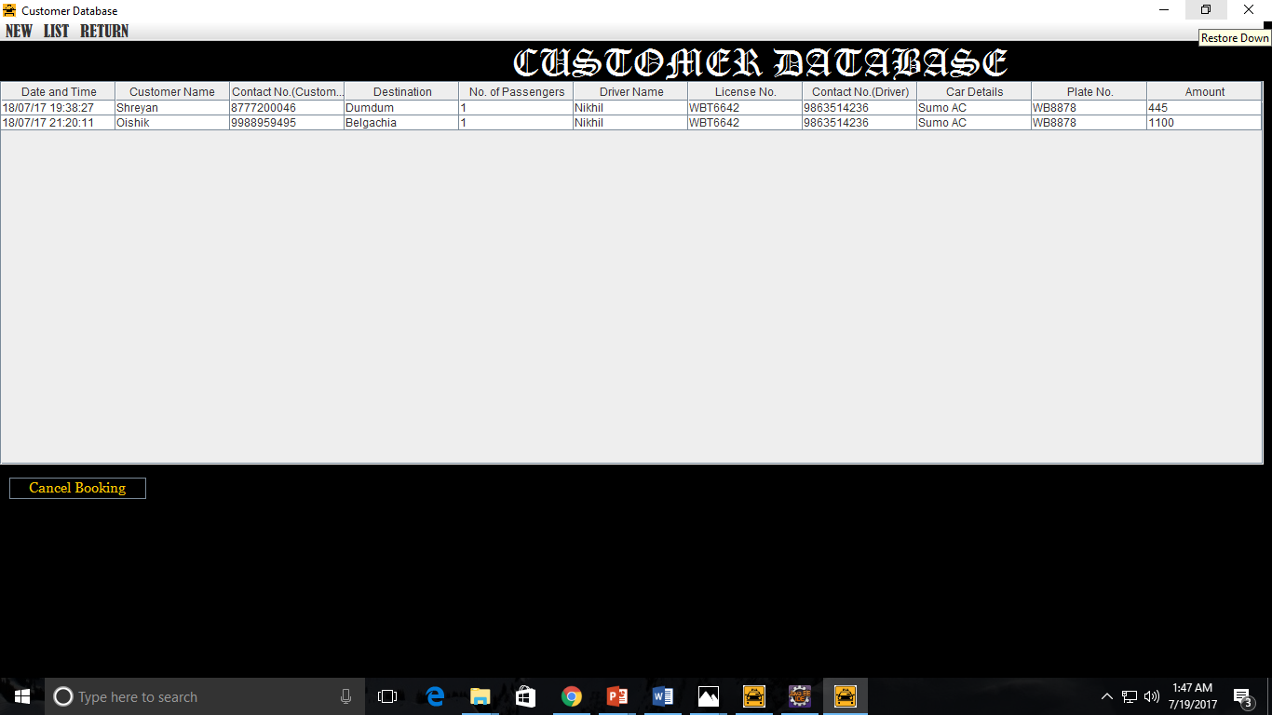
CUSTOMER DATABASE

Slide 12
FUTURE SCOPE OF IMPROVEMENT
Administrator Login: Admin can manage number of users.
Forget Password : Upon forgetting password, user can change the same by following A few easy steps.
Manage Profile : User can manage their account like, changing username or photo, etc.
Dynamic Driver Database: Drivers are made available or unavailable on the basis of whether they are currently on a job or not.

Slide 13
ACKNOWLEDGEMENT
We take this oppourtunity to express profound gratitude and deep regards to our faculty Mr. Dayamay Halder for his guidance, monitoring and constant encouragement throughout the course of this project. His frequent blessings, help and cooperation shall carry us a long way in the journey of life on which we are about to embark. Also a heartiest thanks to Team Globsyn for organizing the entire training procedure.

Slide 14
THANK YOU

